Slide 1
SESSION:11
Machine Language
Assembly Language
The Assembler
Program Loops
Programming Arithmetic & Logic

Slide 2
Machine Language
To write a program for a computer we need to specify, directly or indirectly, a sequence of machine instructions. Machine instructions inside the computer form a binary pattern, which is difficult to understand and manipulate. The instruction set of the basic computer, whose hardware organization was explored earlier used to program a computer. The 25 instructions of the basic computer are in Table 4.5 to provide an easy reference for the programming examples that follow.

Slide 3
Symbol
Hexadecimal code
Description
AND
0 or 8
AND M to AC
ADD
1 or 9
Add M to AC, carry to E
LDA
2 or A
Load AC from M
STA
3 or B
Store AC in M
BUN
4 or C
Branch unconditionally to m
BSA
5 or D
Save return address in m and branch to m+1
ISZ
6 or E
Increment M and skip if zero
CLA
7800
Clear AC
CLE
7400
Clear E

Slide 4
CMA
7200
Complement AC
CME
7100
Complement E
CIR
7080
Circulate right E and AC
CIL
7040
Circulate left E and AC
INC
7020
Increment AC
SPA
7010
Skip if AC is positive
SNA
7008
Skip if AC is negative
SZA
7004
Skip if AC is zero
SZE
7002
Skip if E is zero
HLT
7001
Halt computer

Slide 5
INP
F800
Input information and clear flag
OUT
F400
Output information and clear flag
SKI
F200
Skip if input flag is on
SKO
F100
Skip if output flag is on
ION
F080
Turn interrupt on
IOF
F040
Turn interrupt off

Slide 6
A program is a list of instructions to tell the computer to do needed processing on the data. We can write a program for a computer in various types of programming languages, but this program can be executed by the computer only when it is in binary form. If it is written in some other language it has to be translated to the binary form so that it can be executed by the computer.

Slide 7
Location
Instruction Code
0
0010
0000
0000
0100
1
0001
0000
0000
0101
10
0011
0000
0000
0110
11
0111
0000
0000
0001
100
0000
0000
0101
0011
101
1111
1111
1110
1001
110
0000
0000
0000
0000

Slide 8
Assembly Language
As we know that a programming language is defined by a set of rules. If users want their programs to be translated correctly they must conform to all formats and rules of the language. Every digital computer has its own separate assembly language. The rules for writing assembly language programs are available from the computer manufacturer in the form of documents and manuals.

Slide 9
A line of code is the fundamental unit of an assembly language program. The specific language is defined by a group of rules. This group describes the symbols that can be used. It also tells how a line of code can be made from them. We will now give the rules to write assembly language programs for the basic computer.

Slide 10
Rules for the Assembly Language
A line of code of an assembly language program is divided in three columns called fields. The fields describe the following information.
1.The label: may be empty or it may specify a symbolic address.
2.The instruction: specifies a machine instruction or a pseudo-instruction.
3.The comment: may be empty or it may include a comment.

Slide 11
A symbolic address has one, two, or three alphanumeric characters. But it cannot have more than three alphanumeric characters. The first character is an alphabet; the next two may be alphabets or numeric digits. We can choose the symbols arbitrarily. A symbolic address in the label field is terminated by a comma to make it a label. The instruction field specifies one of the following items:

Slide 12
1.A memory-reference instruction (MRI)
2.A register-reference (i.e. input-output instruction) (non-MRI)
3.A pseudo-instruction with or without an operand

Slide 13
Symbol Information for the Assembler
ORG N
    Hexadecimal number N is the memory location for the instruction or operand listed in the following line
END
    Denotes the end of symbolic program
DEC N
    Signed decimal number N to be converted to binary
HEX N
    Hexadecimal number N to be converted to binary

Slide 14
Student Activity
1.Discuss the advantages and disadvantages of machine language and assembly language.
2.Write an assembly language program to subtract two numbers.
3.Draw flow chart of computer description.

Slide 15
The Assembler
An assembler is a program that takes as input a symbolic language program and produces as output its binary machine language equivalent. The input is called the source program and the resulting binary program is called the object program. The assembler is a program that operates on character strings and produces an equivalent binary interpretation.

Slide 16
Memory Representation of Symbolic Program
The symbolic program must be stored in memory, before starting the assembly process. The user writes the symbolic program on a computer. This symbolic program is taken into memory with the help of a loader program. Since the program consists of symbols, its representation in memory must use an alphanumeric character code. Usually each character is represented by an 8-bit code, in the basic computer. The high-order bit is always 0 and the other seven bits are as described by ASCII code.

Slide 17
Hexadecimal Character Code

Slide 18
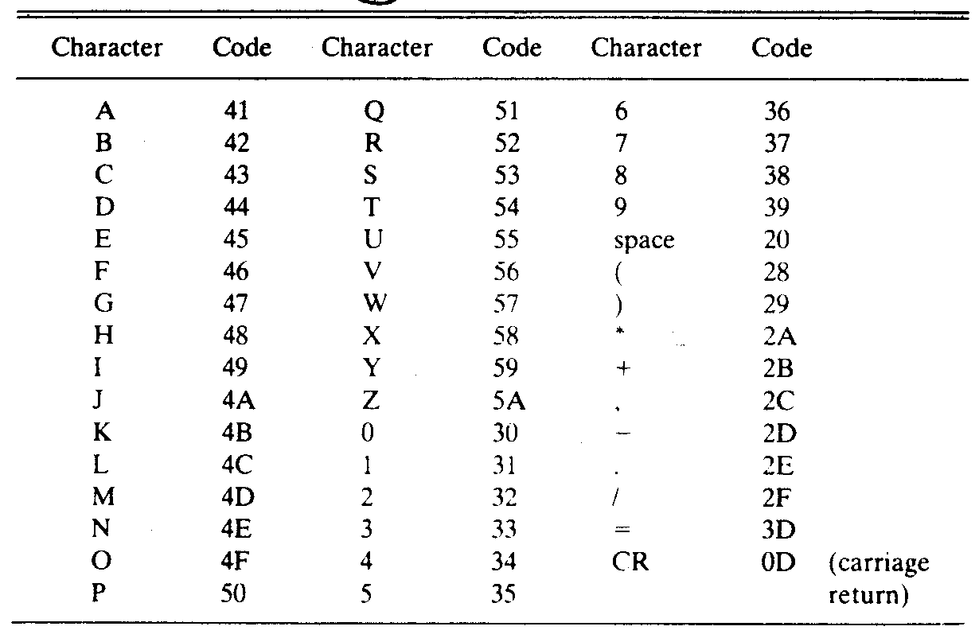

Slide 19
First Pass
Entire symbolic program is scanned by a two-pass assembler twice. After the first pass, it generates a table that correlates all user-defined symbols with their equivalent value in binary. The binary translation is done during the second pass. To keep track of the location of instructions, the assembler uses a memory word called a location counter (abbreviated LC). The content of LC stores the value of the memory location assigned to the instruction or operand presently being processed.

Slide 20
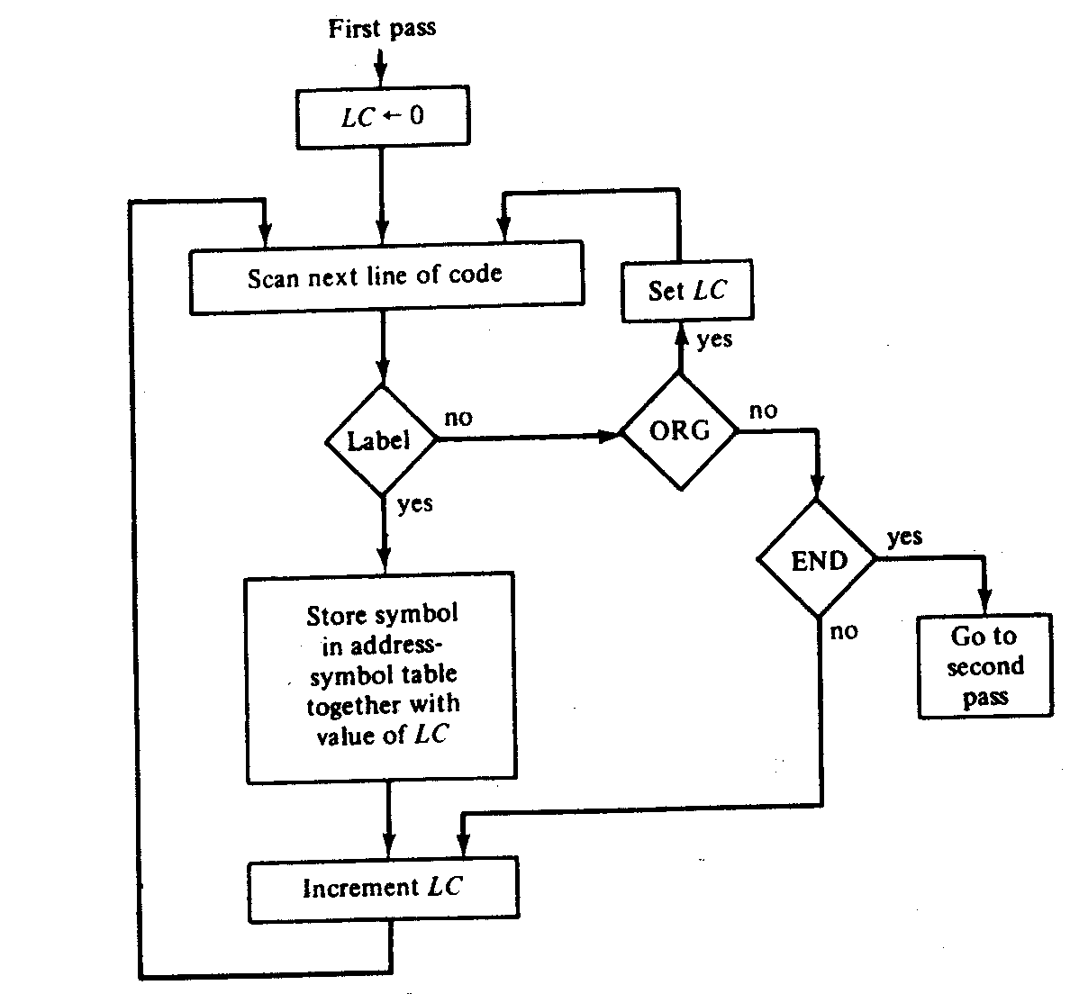

Slide 21
Second Pass
With the help of table-lookup procedures, machine instructions are translated during the second pass. A take-lookup procedure is a search of table entries to find whether a specific item matches one of the items stored in the table. The assembler uses four tables. Any symbol that is encountered in the program must be available as an entry in one of these tables; otherwise, the symbol cannot be interpreted. We assign the following names to the four tables:
1. Pseudo-instruction table.
2. MRI table.
3. Non-MRI table.
4. Address symbol table.

Slide 22
Student Activity
Why assembler is a two-pass software?
Describe first pass of an assembler by flow-chart.

Slide 23
Program Loop
A sequence of instructions that are executed many times, each time with a different set of data is called a program loop. In Fortran, program loops are designated by a DO statement. For example, the following Fortran program forms the sum of 100 integer numbers.

Slide 24
A compiler is a system program that translates a program written in a high-level programming language such as the above to a machine language program. A compiler is more complicated than an assembler because it requires knowledge of systems programming to fully understand its operation. Nevertheless, we can demonstrate the basic functions of a compiler by going through the process of translating the program above to an assembly language program. A compiler may use an assembly language as an intermediate step in the translation or may translate the program directly to binary.

Slide 25
Programming Arithmetic and Logic Operations
In a large system the number of instructions available in a computer may be a few hundred or a few dozen in a small one. Some computers execute a given operation with one machine instruction; some may require many machine instructions to perform the same operation. For example, consider the four basic arithmetic operations. Some computers have machine instructions to add, subtract, multiply, and divide. Others, such as the basic computer, have only one arithmetic instruction, such as ADD. Operations not included in the set of machine instructions must be implemented by a program.

Slide 26
Multiplication Program
The multiplication process consists of checking the bits of the multiplier Y and adding the multiplicand X as many times as there are 1's in Y, provided that the value of X is shifted left from one line to the next. Since the computer can add only two numbers at a time, we reserve a memory location, denoted by P, to store intermediate sums. The intermediate sums are called partial products since they hold a partial product until all numbers are added. As shown in the numerical example under P, the partial product starts with zero. The multiplicand X is added to the content of P for each bit of the multiplier Y that is 1. The value of X is shifted left after checking each bit of the multiplier. The final value in P forms the product. The example has numbers with four significant bits. When multiplied, the product contains eight significant bits. The computer can use numbers with eight significant bits to produce a product of up to 16 bits.

Slide 27
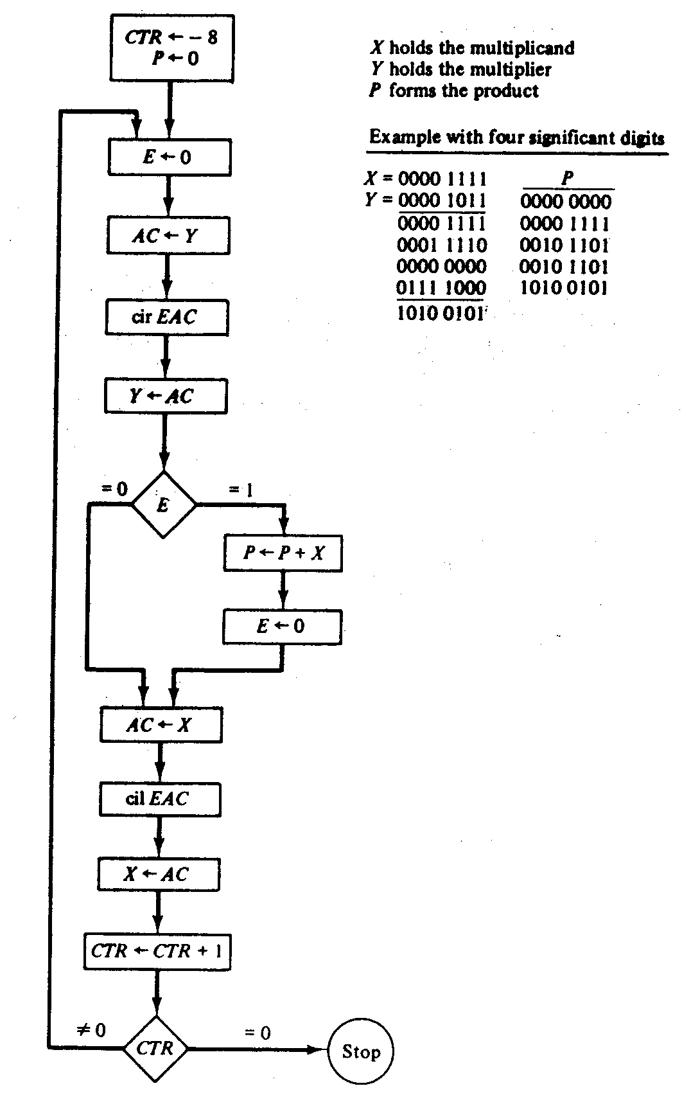

Slide 28
Double-Precision Addition
When we multiply two 16-bit unsigned numbers, the result is a 32-bit product and it must be stored in two memory words. A number is said to have double precision if it is stored in two memory words. When a partial product is computed, it is necessary that a double-precision number be added to the shifted multiplicand, which is also a double-precision number. For greater accuracy, the programmer may wish to employ double-precision numbers and perform arithmetic with operands that occupy two memory words. We now develop a program that adds two double-precision numbers.

Slide 29
Program to Add Two Double-Precision Numbers

Slide 30
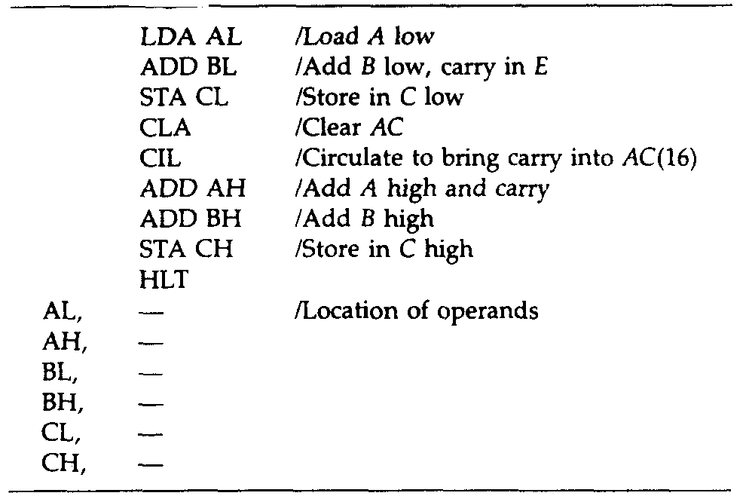

Slide 31
Logic Operations
To perform logic operations: AND, CMA, and CLA, a basic computer has three machine instructions. The LDA instruction is considered as a logic operation that transfers a logic operand into the AC. We listed 16 different logic operations earlier, similarly all 16 logic operations can be implemented by software means because any logic function can be implemented using the AND and complement operations. For example, the OR operation is not available as a machine instruction in the basic computer. From DeMorgan's theorem we recognize the relation x + y = (x'y')'. The second expression contains only AND and complement operations. A program that forms the OR operation of two logic operands A and B is as follows:

Slide 32
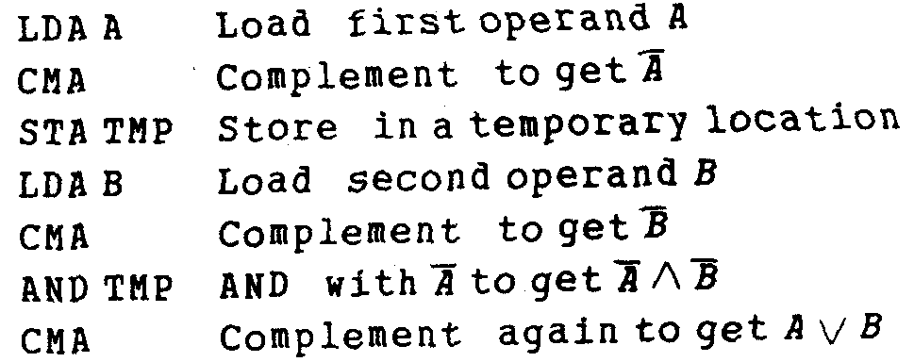

Slide 33
Shift Operations
In a basic computer, the circular-shift operations are machine instructions. The other interesting shifts are the logical shifts and arithmetic shifts. We can program these two shifts with a small number of instructions.
To perform the logical shift requires zeros are added to the extreme positions. This can be easily accomplished by clearing E and circulating the AC and E. Thus for a logical shift-right operation we need the two instructions

Slide 34
CLE
CIR
For a logical shift-left operation we need the two instructions
CLE
CIL

Slide 35
Student Activity
1.What is a program loop?
2.Draw flow chart of multiplication program.
3.Describe CLE and CIR operation.

Slide 36
Subroutines
A subroutine consists of a self-contained sequence of instructions that performs a given task. A branch can be made to the subroutine from any part of the main program. Now there is a problem as to how the subroutine knows which location to return to, since many different locations in the main program may make branches to the same subroutine. It is therefore necessary to store the return address somewhere in the computer for the subroutine to know where to return. Since branching to a subroutine and returning to the main program is such a common operation, all computers provide special instructions to facilitate subroutine entry and return.

Slide 37
Program to Demonstrate the Use of Subroutines

Slide 38
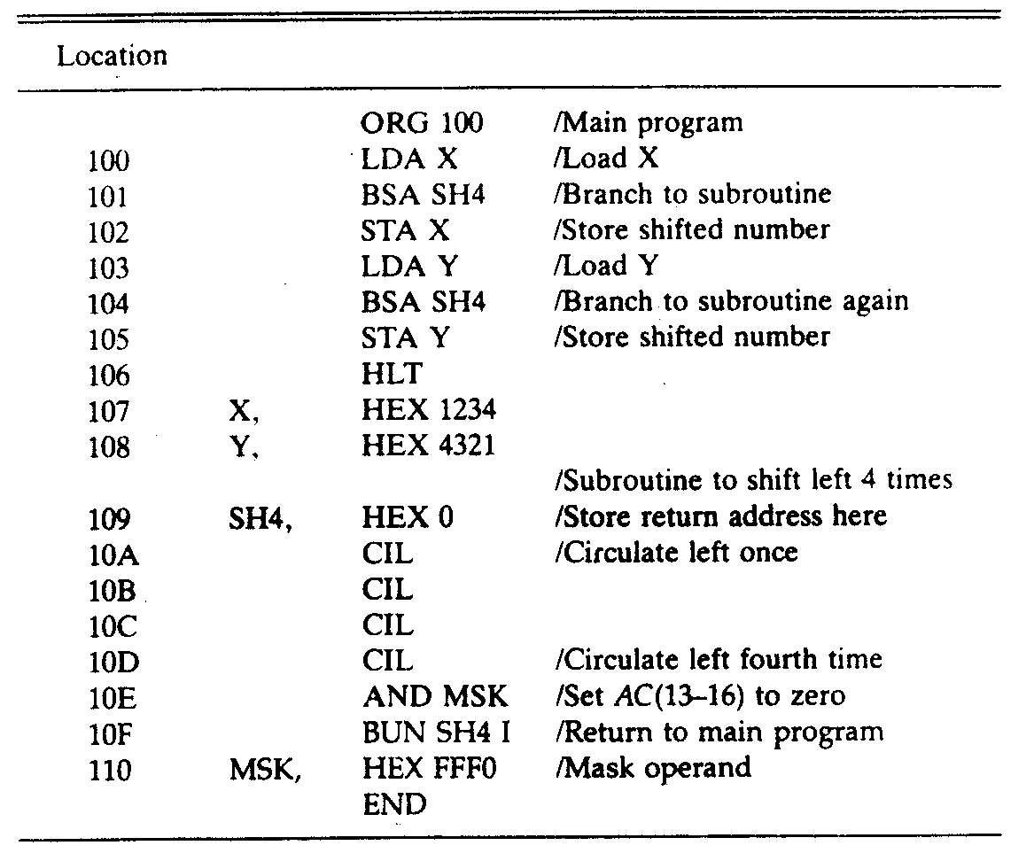

Slide 39
Subroutine Parameters and Data Linkage
The accumulator is generally used for a single input parameter and a single output parameter. More parameters can be transferred this way, in computers with multiple processor registers. Another method to transfer data to a subroutine is through the memory. Data are often placed in memory locations following the call. They can also be placed in a block of storage. The first address of the block is then placed in the memory location following the call. In any case, the return address always gives the link information for transferring data between the main program and the subroutine.

Slide 40
Program to Demonstrate Parameter Linkage

Slide 41
